Slide 1
Analyzing “Hidden Patterns” in Stock Data Rutgers Data Science Bootcamp
Jan 12, 2018
Team 5
David Hui Timothy Yu Raj Ray

Slide 2
Project Scope and Goals (Motivation & Summary)
Objective and Scope
The goal of this project is to uncover patterns in the daily price action of a key stock traded in the US market.
Stock Selected – AAPL (Traded on the NASDAQ Exchange)
Time Interval - 3 year timeframe (2015-2017)
~756 # of Datapoint – 252 trading days per year x 3
Examine potential relationships between
Daily closing price and the day of the month,
Daily stock price and its RSI indicator,
Daily stock price and volume
Data Source & Tools Used
Closing price and Relative Strength Index data
Pulled from the Alphavantage API
Python 3.0
Matplotlib, Jupyter notebook

Slide 3

Key Questions & Data
Questions to Address
Are there certain months that are better for buying or selling?
Does the RSI technical indicator (relative strength indicator) give more accurate signals on a larger timeframe than on a smaller timeframe? (i.e. 1 day vs 1 month)?
Price action and the RSI indicator -Test the assumption that the RSI is more accurate in larger timeframes in identifying overbought and oversold conditions.
Determine if our stock is currently overvalued or oversold based on historical data?
Is it possible to do any predictive analysis based on these patterns? (linear regression/ line fit)

Slide 5
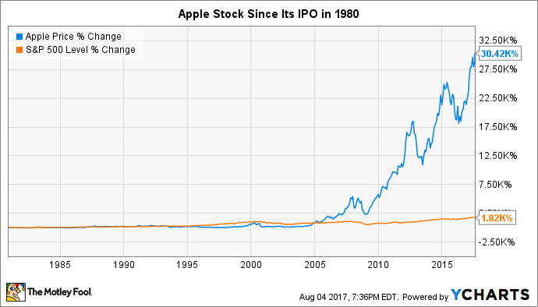
AAPL Stock Price Through the Years

Slide 6
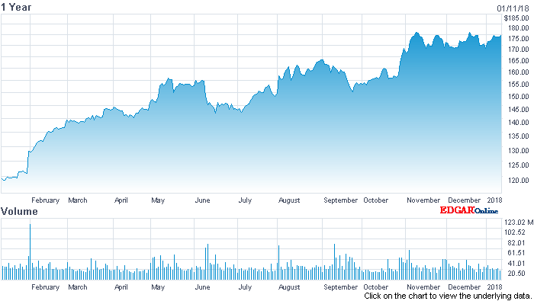

AAPL Stock Price (2017)
Apple Inc. Stock Chart

Slide 7
Data Analysis
Time series analysis was performed by performing Y-O-Y comparisons.

Slide 8
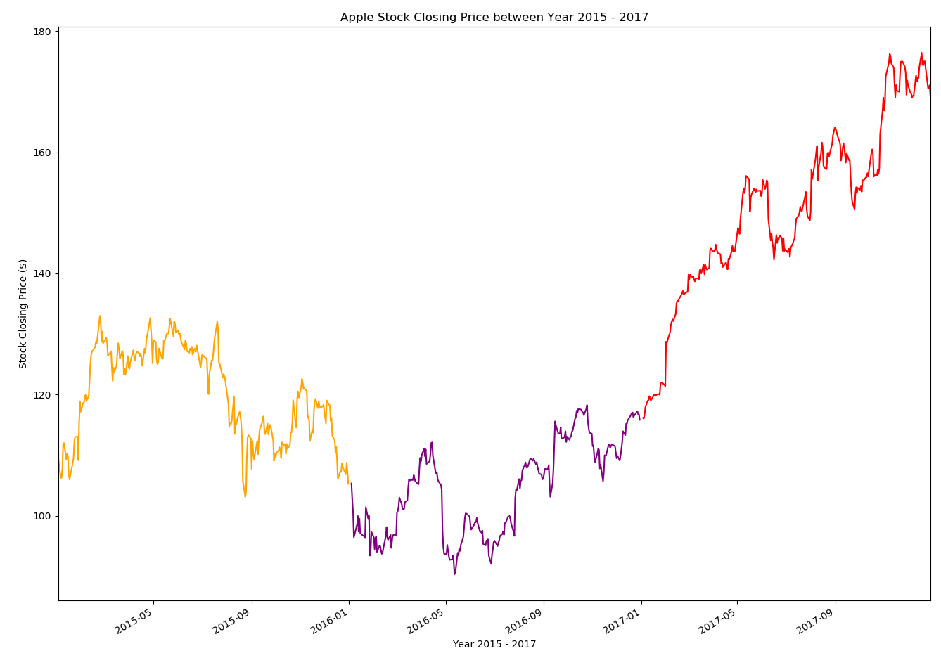
AAPL Stock Closing Price 2015-2017

Slide 9
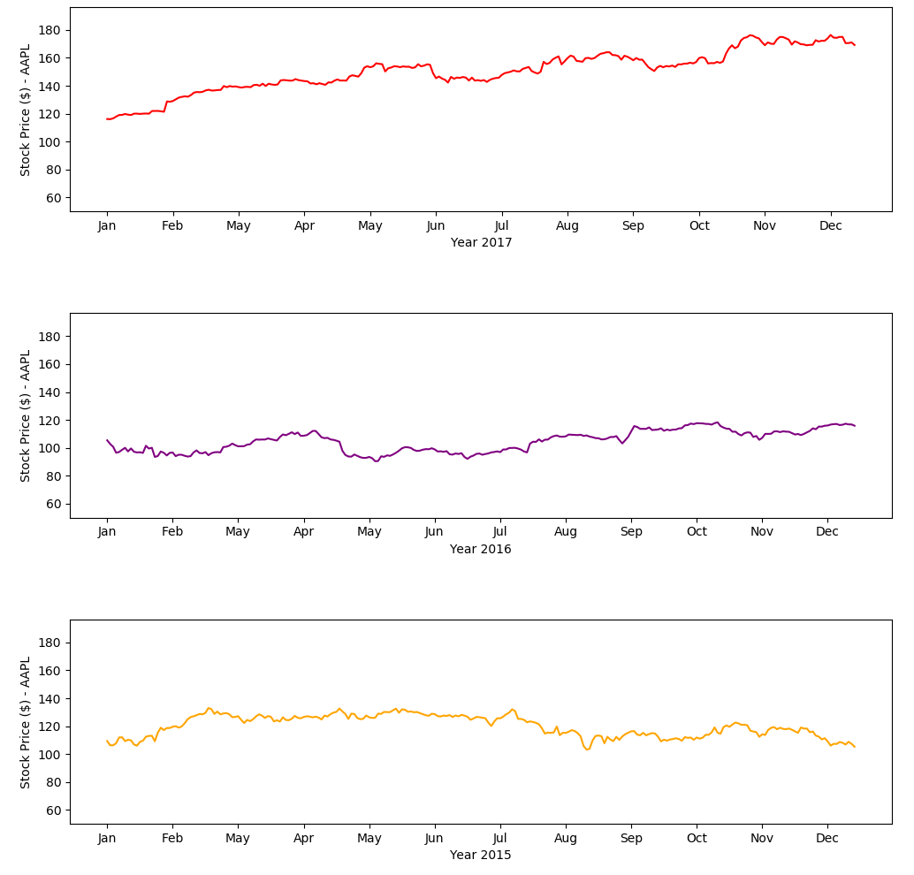
Closing Price

Slide 10
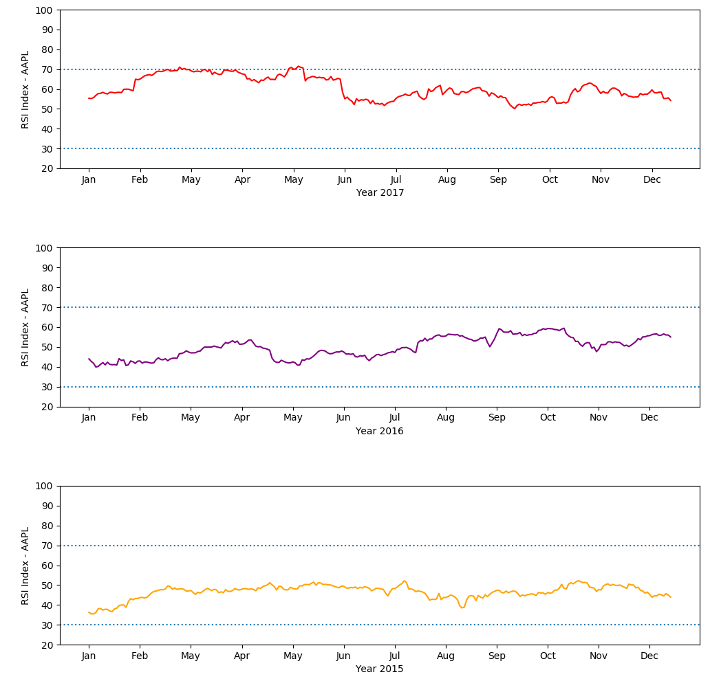
RSI (Relative Strength Index)

Slide 11
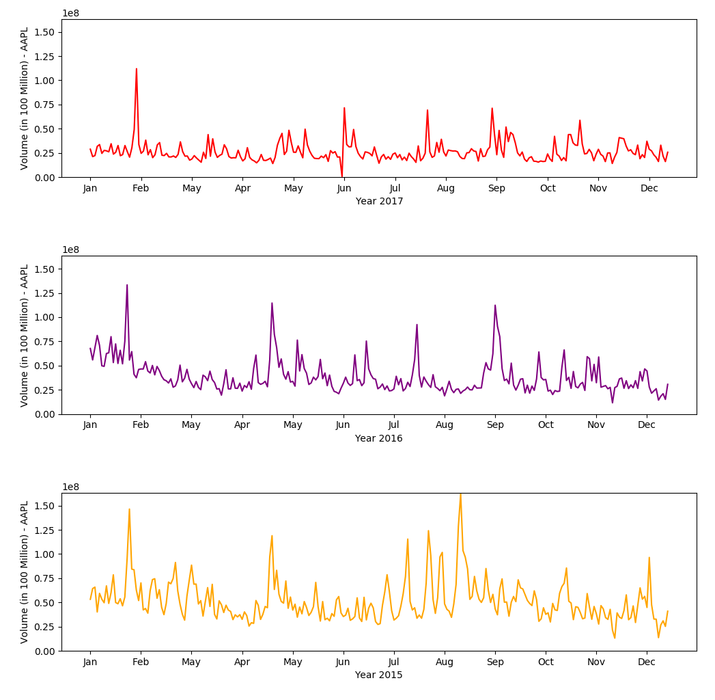
Volume

Slide 12
Data Exploration
Type of Data
Daily close, volume, and relative strength index from Alphavantage API
Data Exploration
Additional data were also available on daily open, daily high, daily low, inter-day data etc. but those data were not considered or eliminated from input data streams to keep the data manageable for our analysis and to prevent scope creep.

Slide 13
Data Cleanup
Data Cleanup
Data from Alphavantage was examined for errors, poor formatting and missing data.

Slide 14
Discussion

Slide 15
Constraints and Limitations
Constraints
Google and Yahoo APIs for stock market data have recently been shut down.
Other stock market APIs are not free.
Limitations
Exact month units and holidays
Single stock vs meta-study of multiple stock
One technical indicator (RSI) vs. many

Slide 16
Conclusions and Lessons Learned
If we had 2+ more weeks to research:

Slide 17
End
Questions?

